Slide 1

EXPLORE AND IMPLEMENT IMAGE AUGMENTATIONS
Worklet ID: RSG32CU
College Name: Chandigarh University

Slide 2
Proposing new image augmentation techniques
1. Flipping with 1 pixel shift
2. Activation Suppressor
3. Adaptive Color Scheme
4. Tiles Shuffling

Slide 3
Flipping with 1 pixel shift
Normal flipping with 1 pixel shift in both horizontal and vertical axes.
The reason to use this augmentation is due to “POOLING LAYERS”

Slide 4

POOLING LAYERS

Slide 5
Pooling with 1 pixel shift
0 | 0 | 0 | 0
0 | 7 | 3 | 5
0 | 8 | 7 | 1
0 | 4 | 9 | 3
Max Pooling
7 | 5
6 | 9

Slide 6
Pixel information
8 | 6
9 | 9
7 | 5
6 | 9
Pooling without 1 pixel shift
Pooling with 1 pixel shift

Slide 7
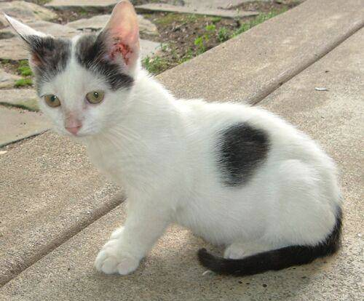
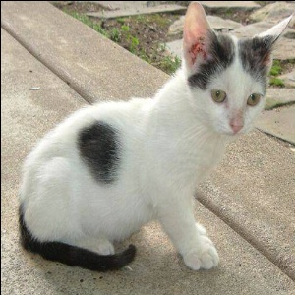
Flipping with 1 pixel shift
Flip + 1 Pixel shift
Original

Slide 8
Improvement in the results
MODEL | CAT ACC | DOG ACC | NET ACC
MODEL A1(Flip without 1 pixel shift) | 89.19% | 79.34% | 84.26%
MODEL A2(Flip with 1 pixel shift) | 86.21% | 86.41% | 86.31%
MODEL B1(Flip without 1 pixel shift) | 93.13% | 83.29% | 88.21%
MODEL B2(Flip with 1 pixel shift) | 88.26% | 88.13% | 88.19%
Training Conditions:
Training Dataset Original: 1500 Cat, 1500 Dog, 1500 NT
Augmented Data (Flip): 1500 Cat, 1500 Dog, 1500 NT
Total: 3000 Cat, 3000 Dog, 3000 Nothing
Testing Conditions:
Testing Dataset: 11000 Cat, 11000 Dog

Slide 9
ACTIVATION Suppressor
The idea here is to suppressor the activation regions in an image learned by the model so that other the model is forced to look at other areas.
The reason to use this augmentation is to encourage the model to make decisions by considering multiple activation areas rather than simply relying on single or less activation areas.

Slide 10
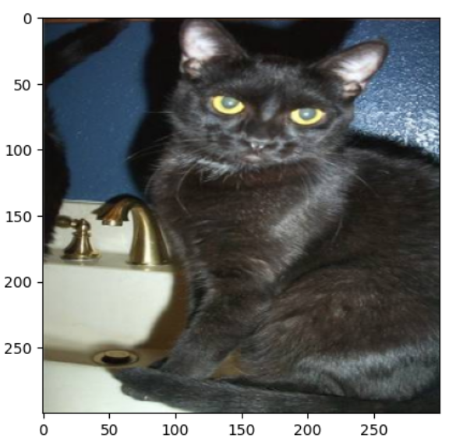
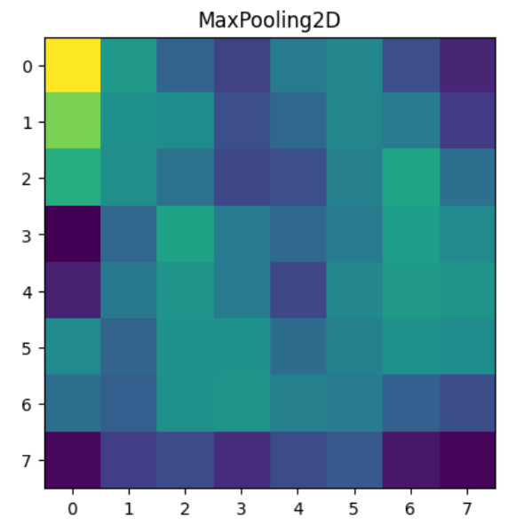
ACTIVATION Suppressor
Without Activation Suppression

Slide 11
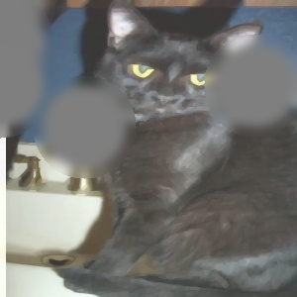
ACTIVATION Suppressor
Suppressing the activations by filling the areas of activations with neural color like gray. And in order to make the model to treat this image as new, we have applied some effects like oil paint.

Slide 12
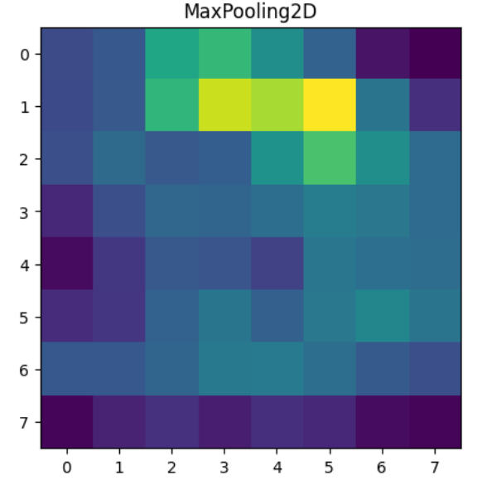
ACTIVATION Suppressor
The model’s activation regions after the suppression.

Slide 13
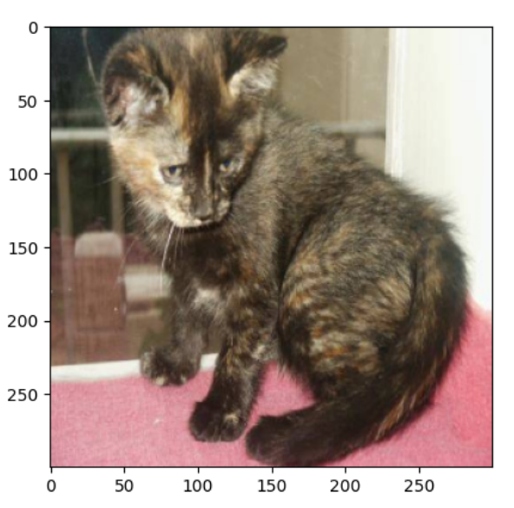
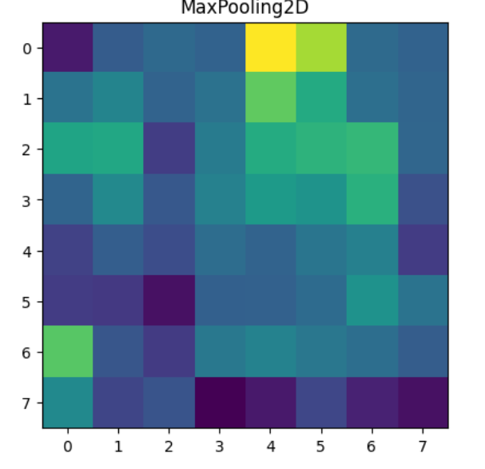
ACTIVATION Suppressor
With Activation Suppression

Slide 14
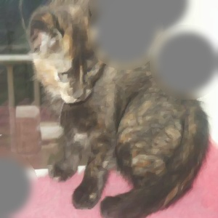
ACTIVATION Suppressor
With Activation Suppression

Slide 15
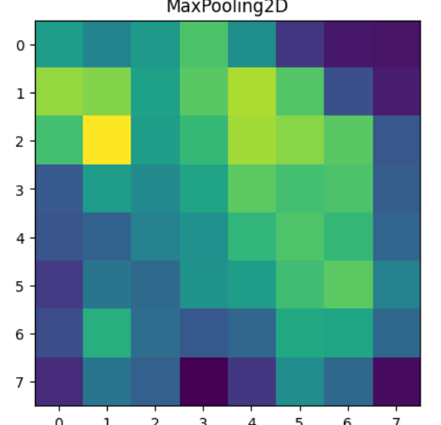
ACTIVATION Suppressor
With Activation Suppression

Slide 16
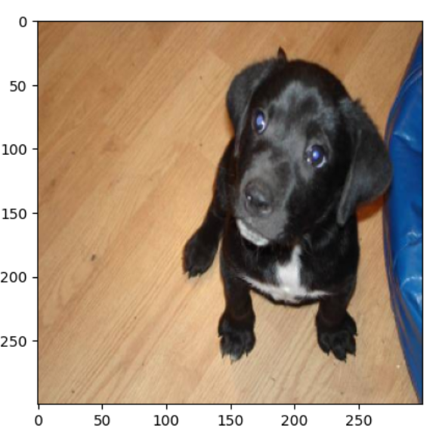
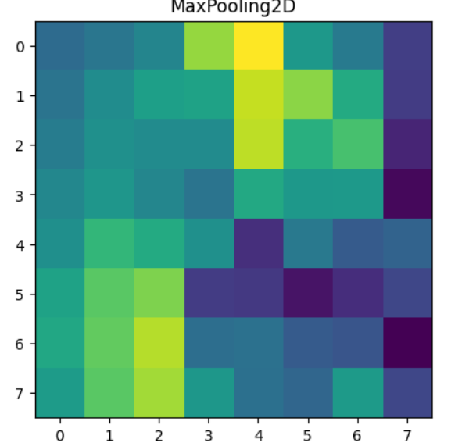
ACTIVATION Suppressor
Without Activation Suppression

Slide 17
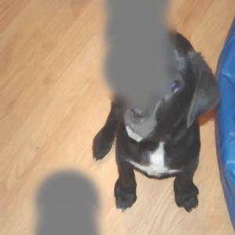
ACTIVATION Suppressor
With Activation Suppression

Slide 18
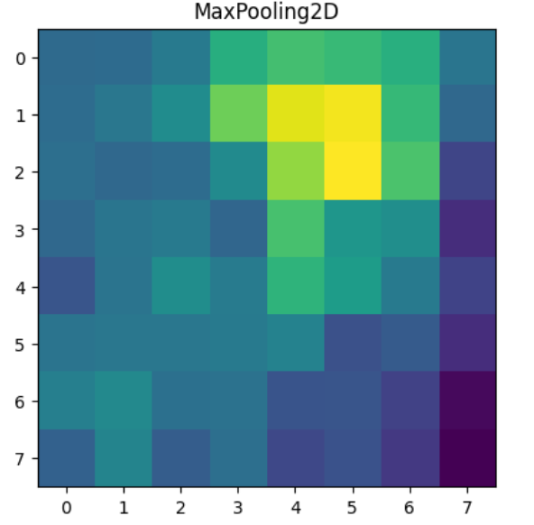
ACTIVATION Suppressor
Without Activation Suppression

Slide 19
ACTIVATION Suppression Working
Finding the activated areas.
Suppressing it by filling with neutral colors like gray.
Apply a style effect on the image

Slide 20
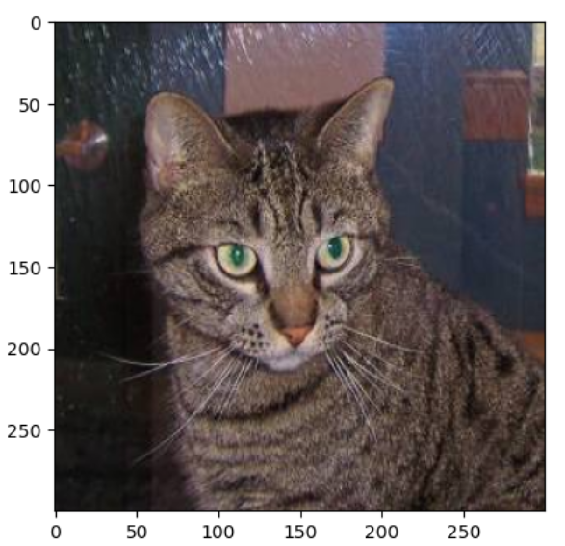
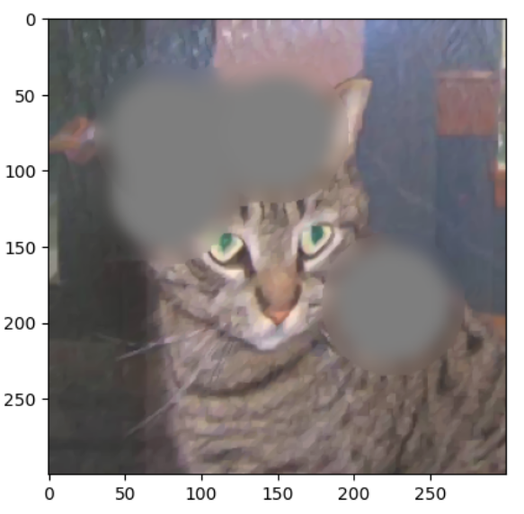
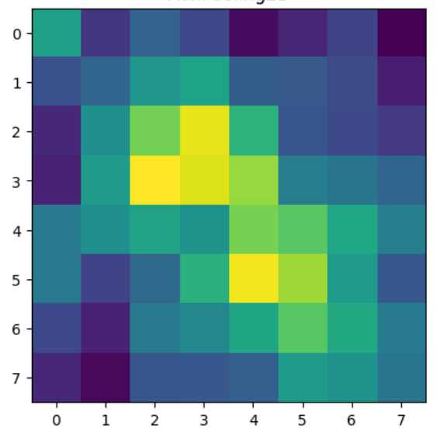
ACTIVATION Suppressor
Suppressing the activated regions
Optimal Activations
Trained Image

Slide 21
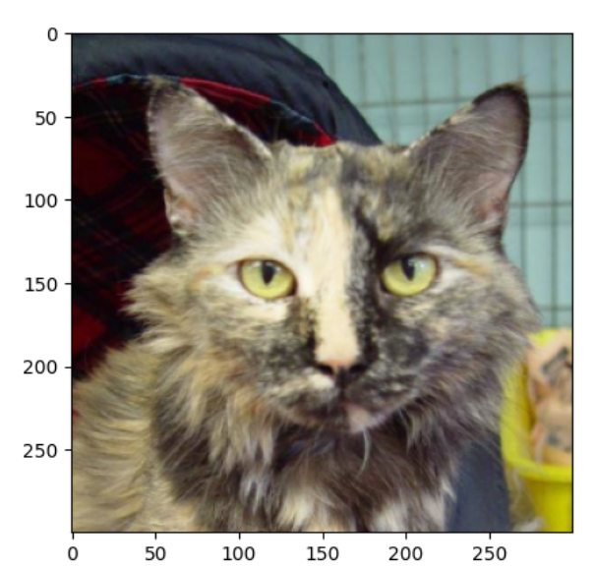
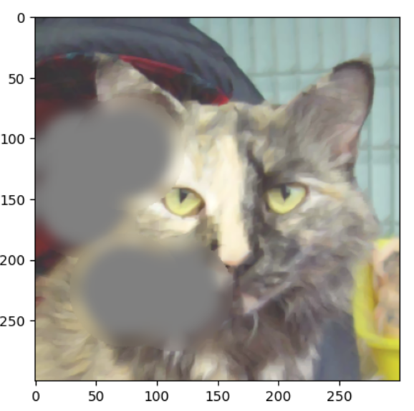
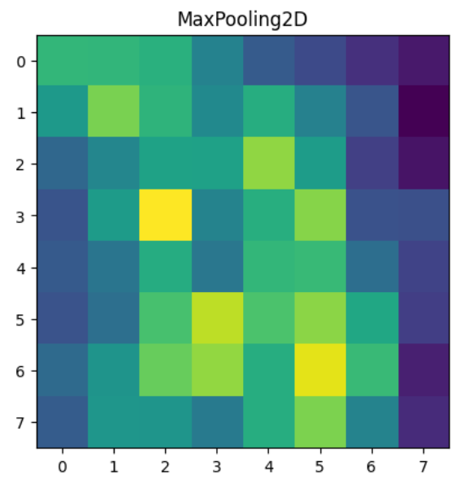
ACTIVATION Suppressor
Suppressing the activated regions
Optimal Activations
Trained Image

Slide 22
Improvement in the results
MODEL | CAT ACC | DOG ACC | NET ACC
MODEL A1(without active suppression) (Base Model) | 94.14% | 78.64% | 86.4%
MODEL A2(with active suppression) | 88.33% | 89.1% | 88.71%
MODEL A3(with active suppression + effect) | 91.21% | 92.82% | 92.015%
MODEL B1(without active suppression) (Base Model) | 74.69% | 85.2% | 79.94%
MODEL B2(with active suppression) | 88.82% | 87.44% | 88.13%
Training Conditions:
Training Dataset Original: 1500 Cat, 1500 Dog, 1500 Nothing
Augmented Data (Suppressed): 1500 Cat, 1500 Dog, 1500 Nt
Total: 3000 Cat, 3000 Dog, 3000 Nothing
Testing Conditions:
Testing Dataset: 11000 Cat, 11000 Dog

Slide 23
Adaptive Color scheme
The main idea here is to analyze the color distribution of images from the training data and overlap the colors which are not present or present in less amount in the current image.

Slide 24
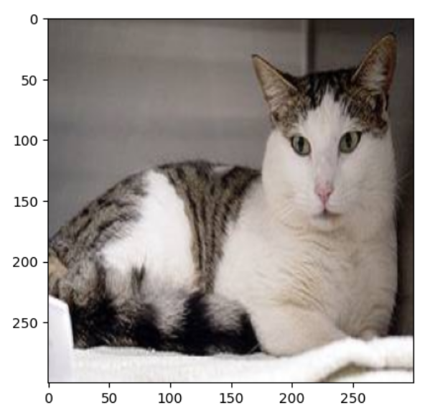
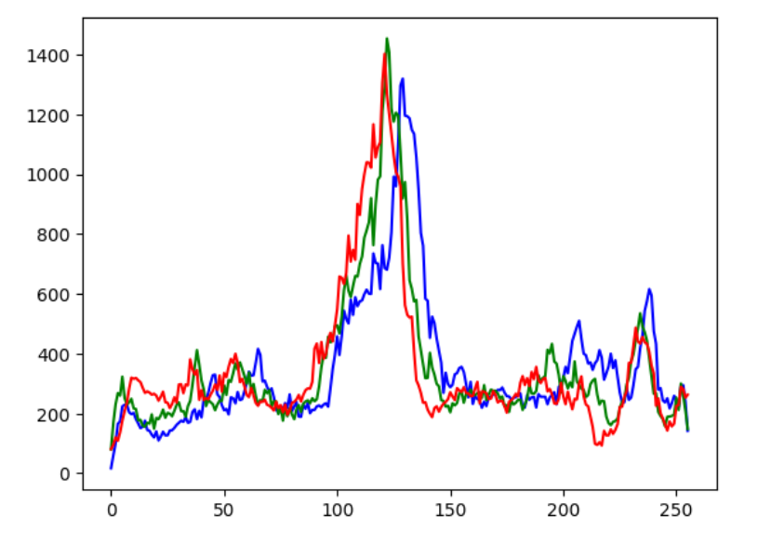
Adaptive Color scheme

Slide 25
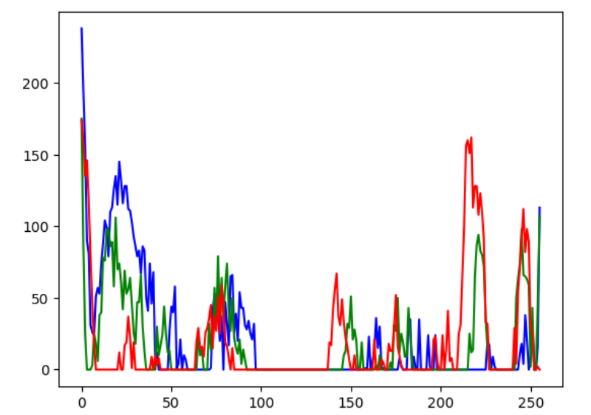
Adaptive Color scheme

Slide 26
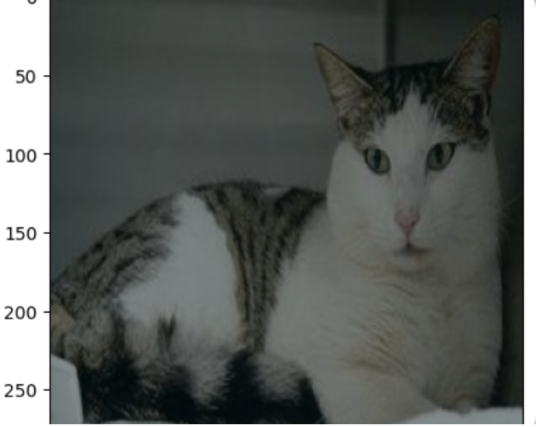
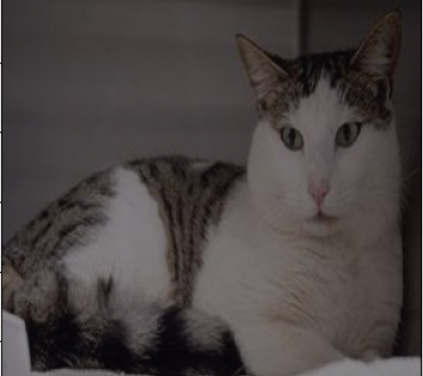
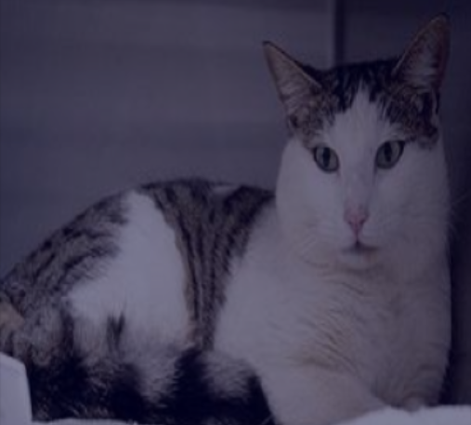
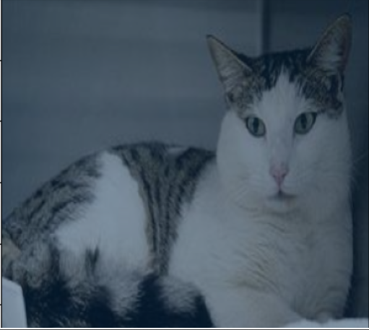
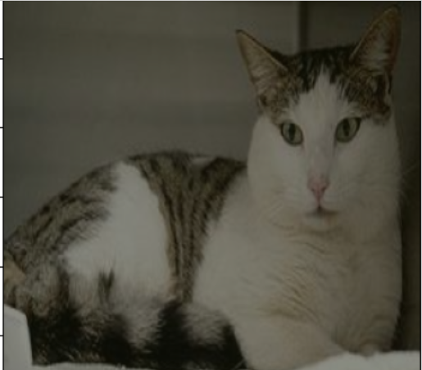
Adaptive Color scheme

Slide 27
Tiles shuffling
This technique is specifically used for binary classification problems. The issue with binary classification problems is that if the model did not find the features of class A then directly it classifies the image as another class irrespective of the contents of the image.
So, in order to solve this, we need to make it a categorical problem by adding another class which is used to specify not both classes.

Slide 28
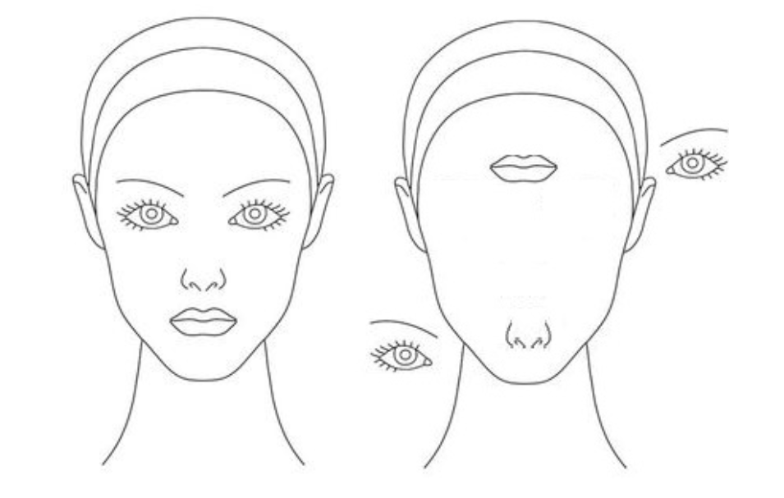
Tiles shuffling
In tiles shuffling, we treat each image as a set of tiles and move them randomly. We will do this for both the classes. This technique is used to stress the spatial learning of the model.

Slide 29
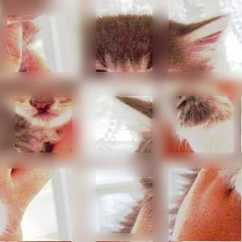
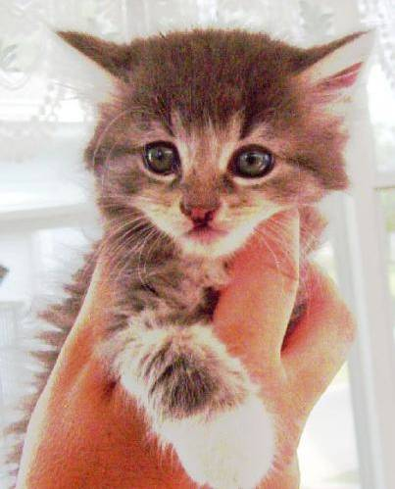
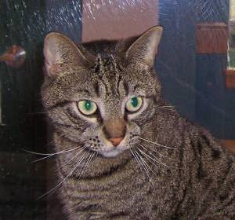
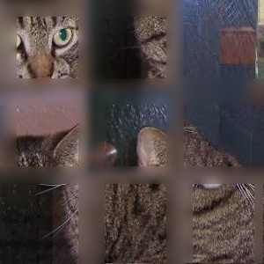
Tiles shuffling
Shuffling
Shuffling

Slide 30
Improvement in the results
MODEL | CAT ACC | DOG ACC | NET ACC
MODEL A1(binary) | 75.1% | 74.55% | 75.32%
MODEL A2(categorical) | 81.56% | 85.2% | 83.38%
Training Conditions:
Training Dataset Original: 1500 Cat, 1500 Dog, 1500 Nothing
Testing Conditions:
Testing Dataset: 11000 Cat, 11000 Dog

Slide 31
THANK YOU

